Slide 1

Replication and MongoDB
Dwight Merriman (@dmerr)
10gen

Slide 2
Basics
A bit like MySQL replication
Asynchronous master/slave
Let’s try it…

Slide 3
Command Line
--master [--oplogSize <MB>]
--slave –source <host> [--only <db>]

Slide 4
The local db
Doesn’t replicate
On master:
local.oplog.$main
local.slaves
On slave:
local.sources
> use local
> db.sources.find()

Slide 5
Administration
> // master
> use local
> db.printReplicationInfo()
> db.slaves.find()
> db.oplog.$main.findOne()
// slave
> use local
> db.printSlaveReplicationInfo()

Slide 6
Topologies
M->S
M->S
->S
->S
M->S
M-/
M<->M *very restrictive

Slide 7
Replica Pairs
--pairwith

Slide 8
Replica Pairs
Replica Sets
A cluster of N servers
Any (one) node can be primary
Consensus election of primary
Automatic failover
Automatic recovery
All writes to primary
Reads can be to primary or a second
Rack and data center aware
ETA: v1.6 July 2010 (“stable”)

Slide 9
Replica Sets – Design Concepts
A write is only truly committed once it has replicated to a majority of servers in the set. (We can wait for confirmation for this though, with getLastError.)
Writes which are committed at the master of the set may be visible before the true cluster-wide commit has occurred. This property, which is more relaxed than some traditional products, makes theoretically achievable performance and availability higher.
On a failover, if there is data which has not replicated form the primary, the data is dropped (see #1).

Slide 10
A Set
Member 1
Member 3
Member 2

Slide 11
A Set
Member 1
Member 3
Member 2
PRIMARY

Slide 12
A Set
Member 1
Member 3
PRIMARY
Member 2
DOWN

Slide 13
A Set
Member 1
Member 3
PRIMARY
Member 2
RECOVER-ING

Slide 14
A Set
Member 1
Member 3
PRIMARY
Member 2

Slide 15
Configuration
{
_id : <setname>,
members: [
{
_id : <ordinal>,
host : <hostname[:port]>,
[, priority: <priority>]
[, arbiterOnly : true]
[, votes : n]
}
, ...
],
settings: {
[heartbeatSleep : <seconds>]
[, heartbeatTimeout : <seconds>]
[, heartbeatConnRetries : <n>]
[, getLastErrorDefaults: <lasterrdefaults>]
}
}

Slide 16
Initiation
> cfg = {
... _id : "acme_a",
... members : [
... { _id : 0, host : "sf1.acme.com" },
... { _id : 1, host : "sf2.acme.com" },
... { _id : 2, host : "sf3.acme.com" } ] }
> use admin
> db.runCommand({replSetInitiate:cfg})

Slide 17
Commands
{ isMaster : 1 }
Checks if the node to which we are connecting is currently primary. Most drivers do this check automatically and then send requires to the current primary.
{ replSetGetStatus : 1 }
Status information on the replica set from this node's point of view.
http://localhost:28017/replSetGetStatus?text
{ replSetInitiate : <config> }
Initiate a replica set.
{ replSetFreeze : <bool> }
Freezing a replica set prevents failovers from occurring. This can be useful during maintenance.

Slide 18
Set Member Types
Normal
DR (priority < 1.0)
Passive (priority == 0)
Arbiter (no data, but can vote)

Slide 19
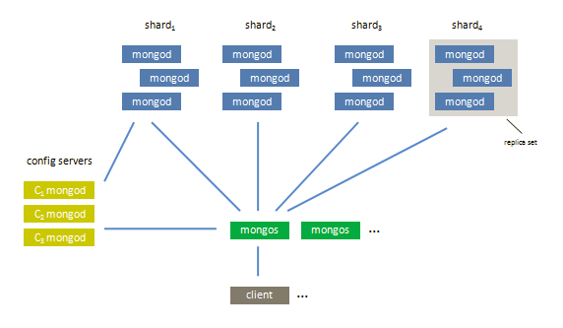
With Sharding

Slide 20
Questions?
Docs: http://www.mongodb.org/display/DOCS/Replica+Sets
Email dwight@10gen.com if you would like
to be a replica set beta tester.
10gen is hiring.

